Slide 1
ALS-P: Light Weight Visible Light Positioning via Ambient Light Sensor
Zeyu Wang¹, Zhice Yang², Qianyi Huang¹, Lin Yang¹, Qian Zhang¹
¹Hong Kong University of Science and Technology
²ShanghaiTech University
Notes:
Good afternoon professors. Thanks for coming my thesis defense. My thesis title is “IoT Architecture Design: Network, Security and Application”

Slide 2
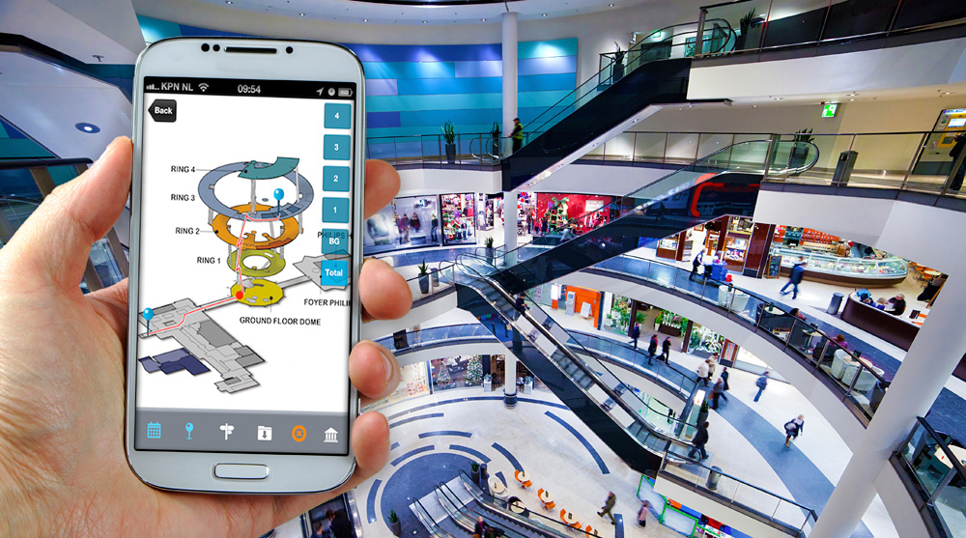
Visible Light Positioning

Slide 3
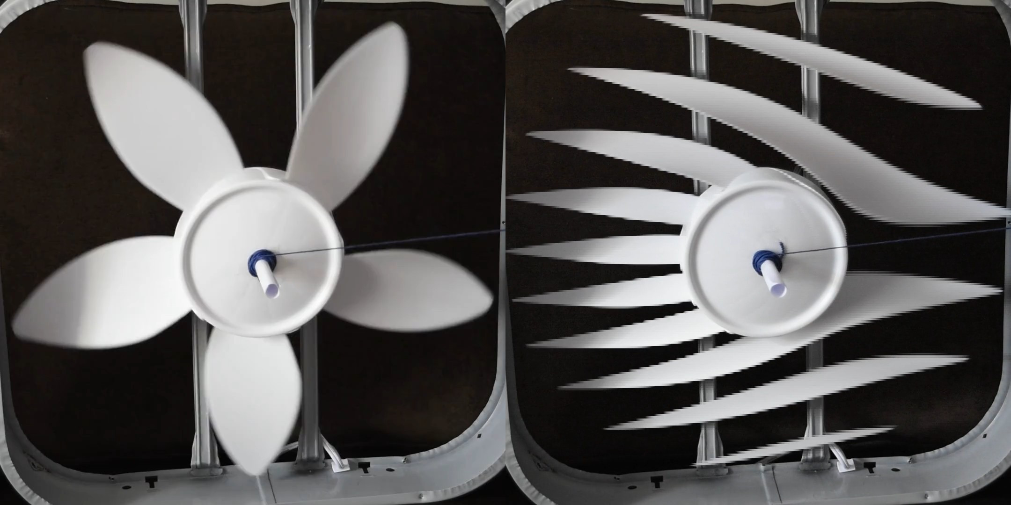
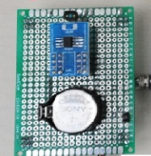
Problem in VLP
Rolling Shutter
High Resolution
High overhead on receiver side to Decode High Rate Signals

Slide 4
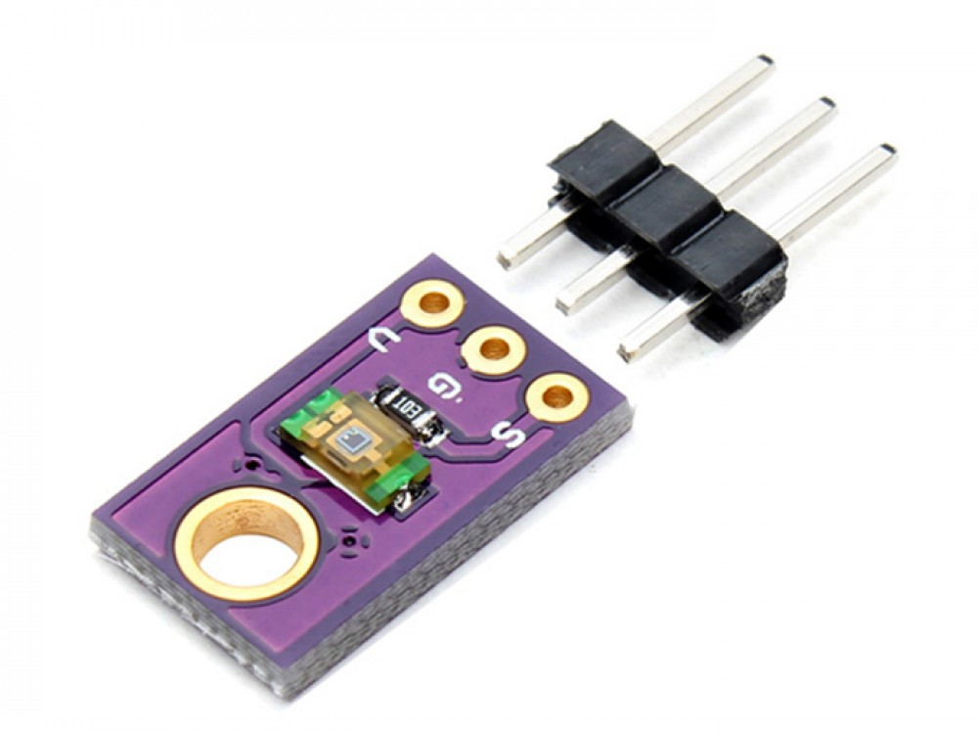
Ambient Light Sensor
Ambient Light Sensor(ALS)
Low sampling rate: 100Hz
Insufficient to decode high rate signal

Slide 5
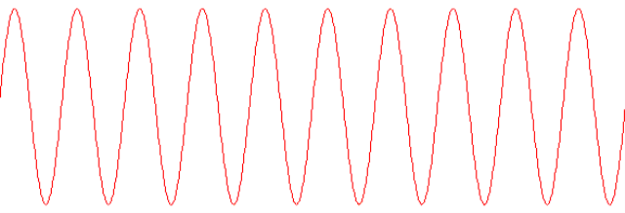
Sub-Sampling: Frequency Aliasing
Low sampling
High sampling
Frequency Aliasing
Low sampling rate can “decode”high rate signal
$$f_{a}=f_{data} mod f_{sampling}$$
Notes:
What is sub-sampling
Why choose sub-sampling
How to use sub-sampling

Slide 6
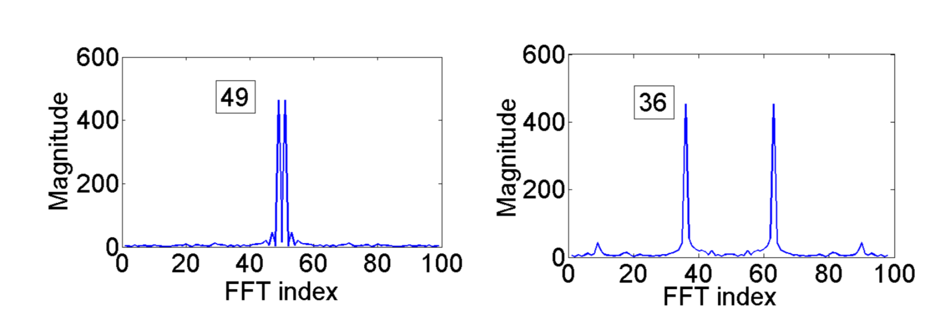
ALS-P: Idea
Dynamic sampling rates
Light of 1251 Hz
100 Hz
99 Hz
1251 mod 100 = 51
1251 mod 99 = 36
Chinese Remainder Theorem

Slide 7
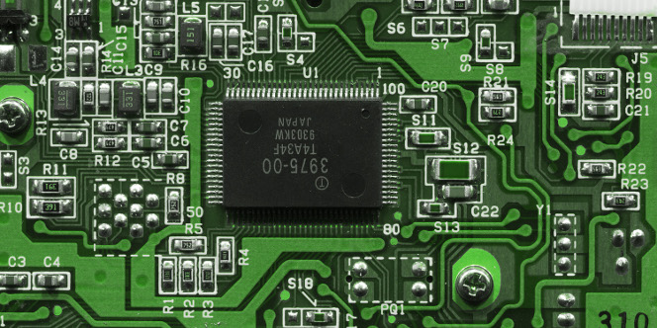
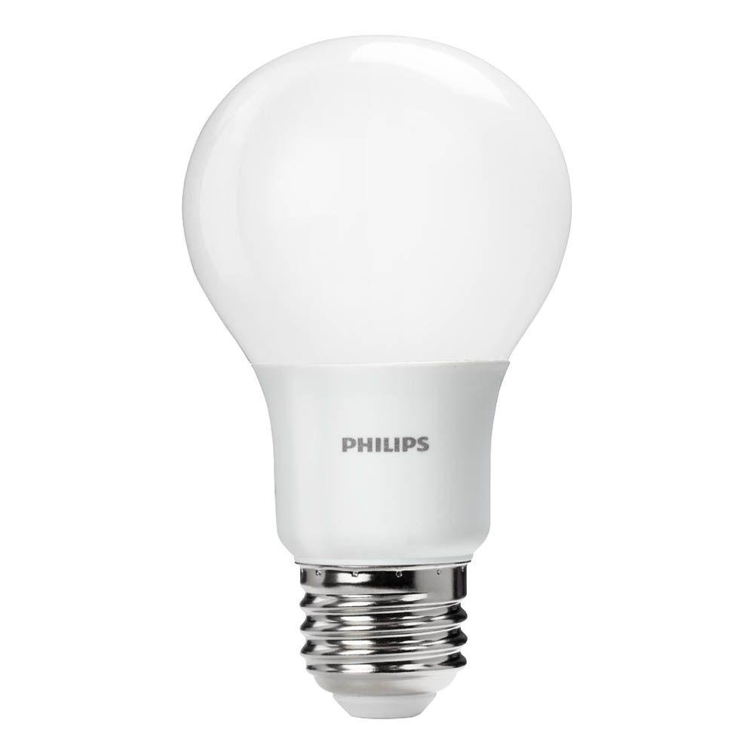
ALS-P: VLP with Sub-Sampling
Frequency is the ID
ALS as the receiver with multiple sampling rates
Longer sampling time

Slide 8
Challenge
ALS is not perfect
ALS sampling is not instantaneous
Different frequency has different response
1Hz
0.67Hz
0.33Hz
0Hz
Integration Time: 1 second

Slide 9
Challenge
ALS is not perfect
Frequency Response Modeling

Slide 10
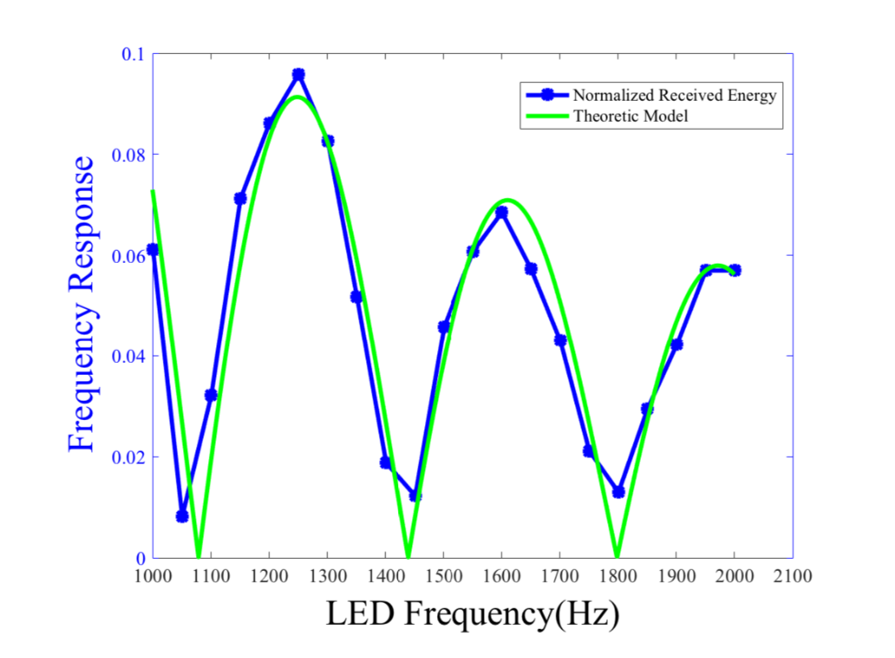
Challenge
Threshold

Slide 11
Challenge
ALS is not perfect
Frequency Response Modeling
Multiple LEDs
Fluorescent Lights
Interference
50/60 Hz
100 Hz
1
3
99 Hz
13
15
1401 Hz
1003 Hz
1203 Hz
1201 Hz

Slide 12
Challenge
ALS is not perfect
Frequency Response Modeling
Interference
Map Assignment and Algorithm

Slide 13
Map Assignment
100 Hz
1
3
99 Hz
13
15
1401 Hz
1003 Hz
1203 Hz
1201 Hz
Wrong
Correct

Slide 14
Localization Algorithm
Existing Localization Algorithm
Levenberg-Marquard

Slide 15
ALS-P: System Overview
Light Sensing
FFT of dual sampling rates
Localization with location of LEDs and received energy
Decoding LEDs' Frequency using FFT peaks and Chinese Remainder Theorem

Slide 16
Implementation
Modulation frequency: 1000Hz ~ 3000Hz

Slide 17
Evaluation
ALS-P Decoding Performance
ALS-P Localization

Slide 18
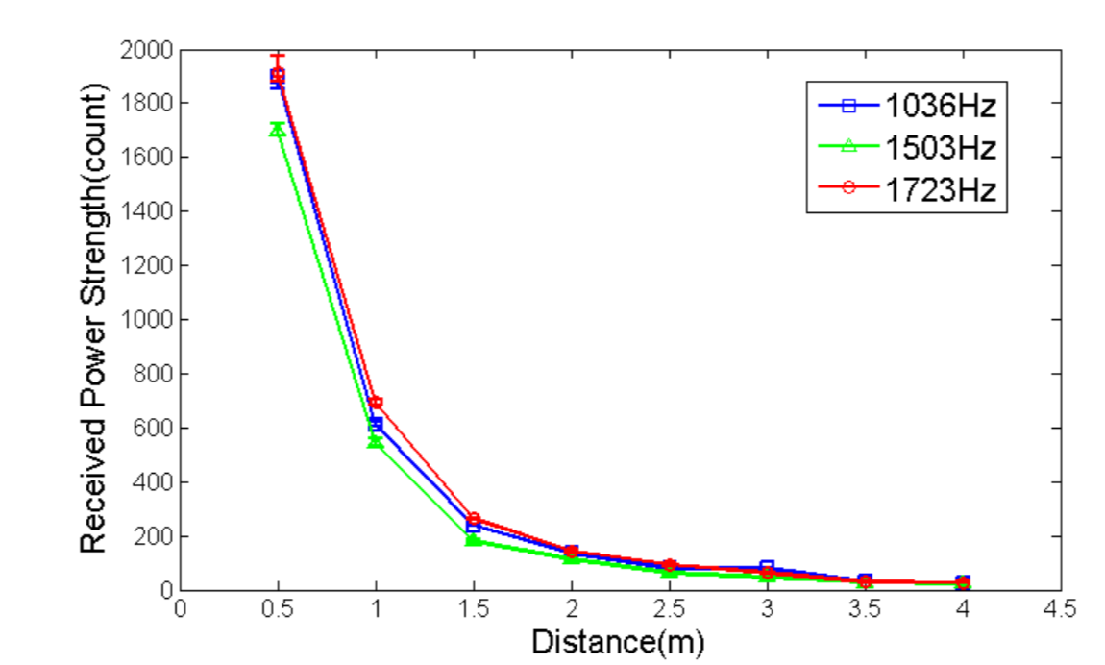
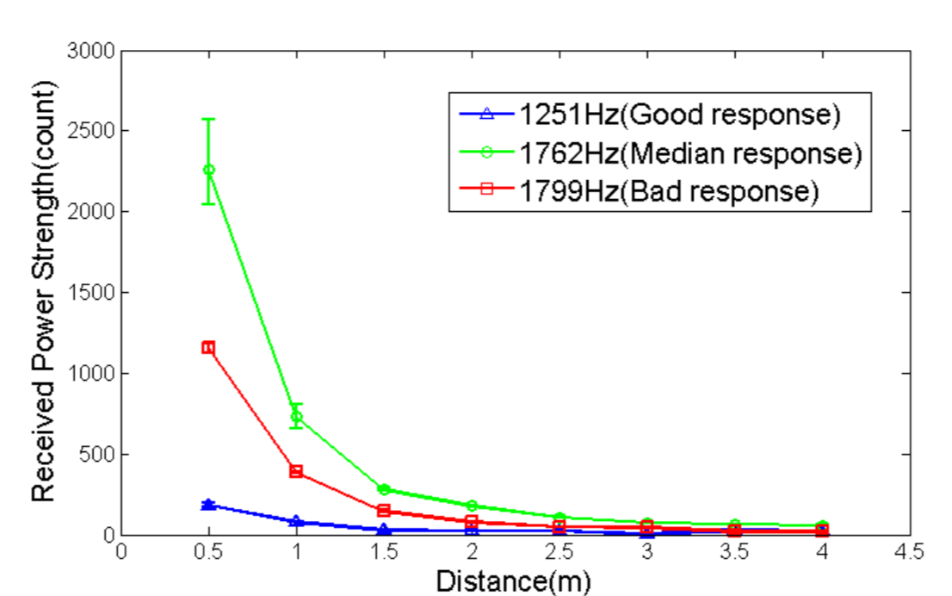
Single LED Bulb

Slide 19
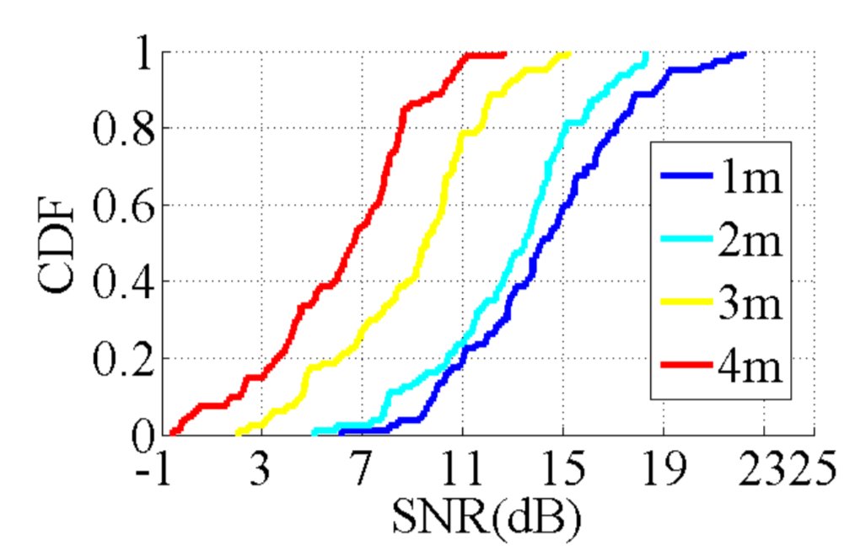
Multiple LED Bulbs

Slide 20
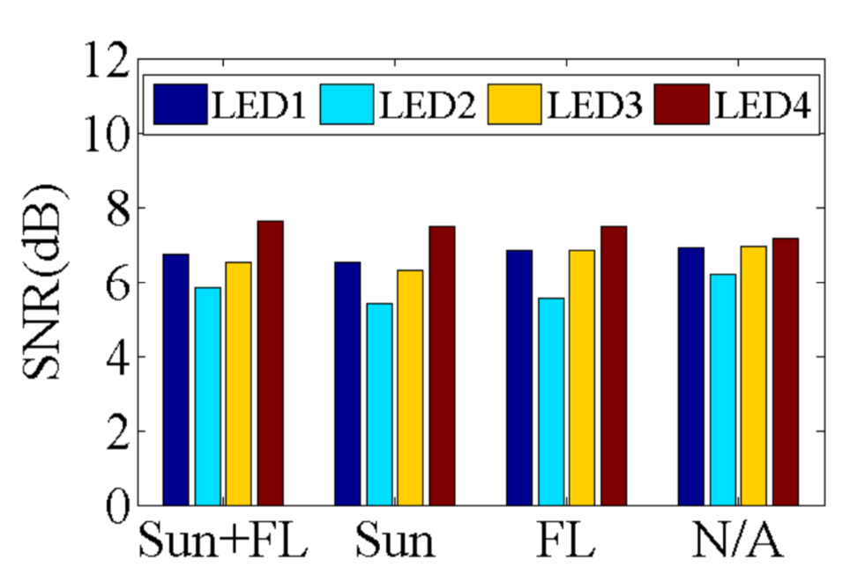
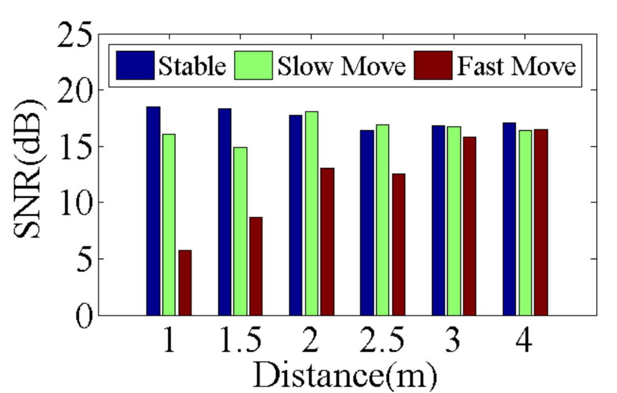
Ambient Effects and Mobility

Slide 21
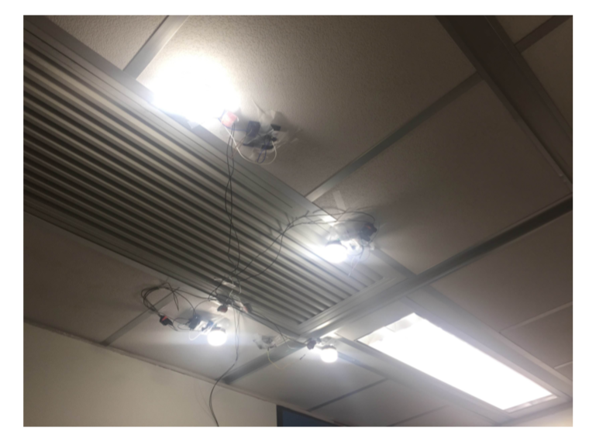
Localization Evaluation

Slide 22
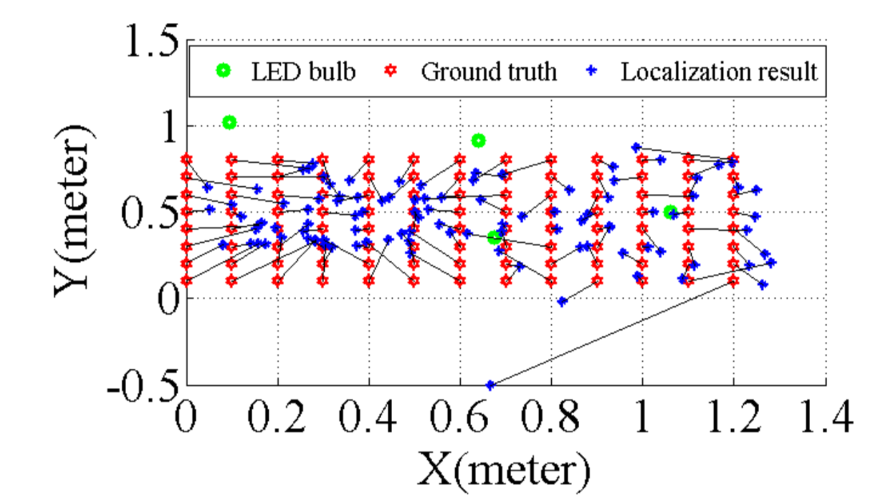
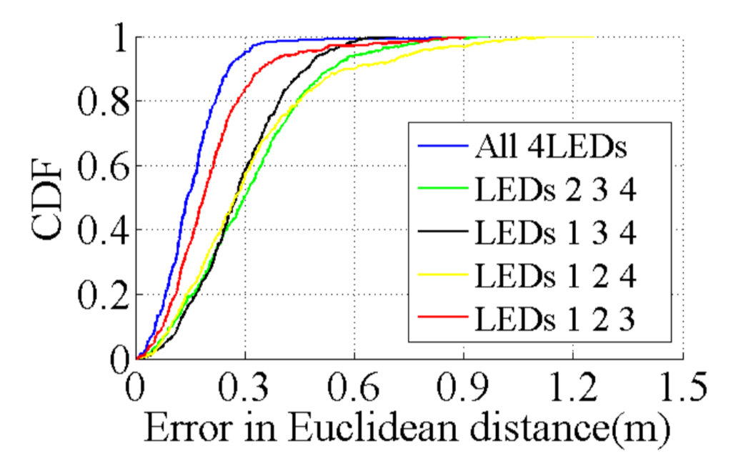
Localization Accuracy

Slide 23
Conclusion
We observe that ALS can be a VLC receiver to sample high-frequency LED via frequency aliasing effect. The further feasibility study validates our idea.
We design ALS- P and propose several schemes for both transmitter and receiver
We implement a prototype of ALS-P and conduct a complete evaluation of it.
The localization result shows that ALS-P can enable lightweight indoor localization with sub-meter level accuracy.

Slide 24
Thank You!

