Slide 1
MousePath: Enhancing PC Web Pages through Smartphone and Optical Mouse
Zhiwei Wang¹, Qianyi Huang², Yihui Yan¹, Haitian Ren¹,
Yizhou Zhang¹, Zhice Yang¹
¹SIST, ShanghaiTech University
²Southern University of Science and Technology, and Peng Cheng Laboratory
Notes:
Hello, everyone. My name is Wang Zhiwei from Shanghaitech University. [Pause]
This work is done with my co-authors.
In this talk, I’m going to introduce a new approach for web pages on the PC to fetch information from a smartphone.

Slide 2
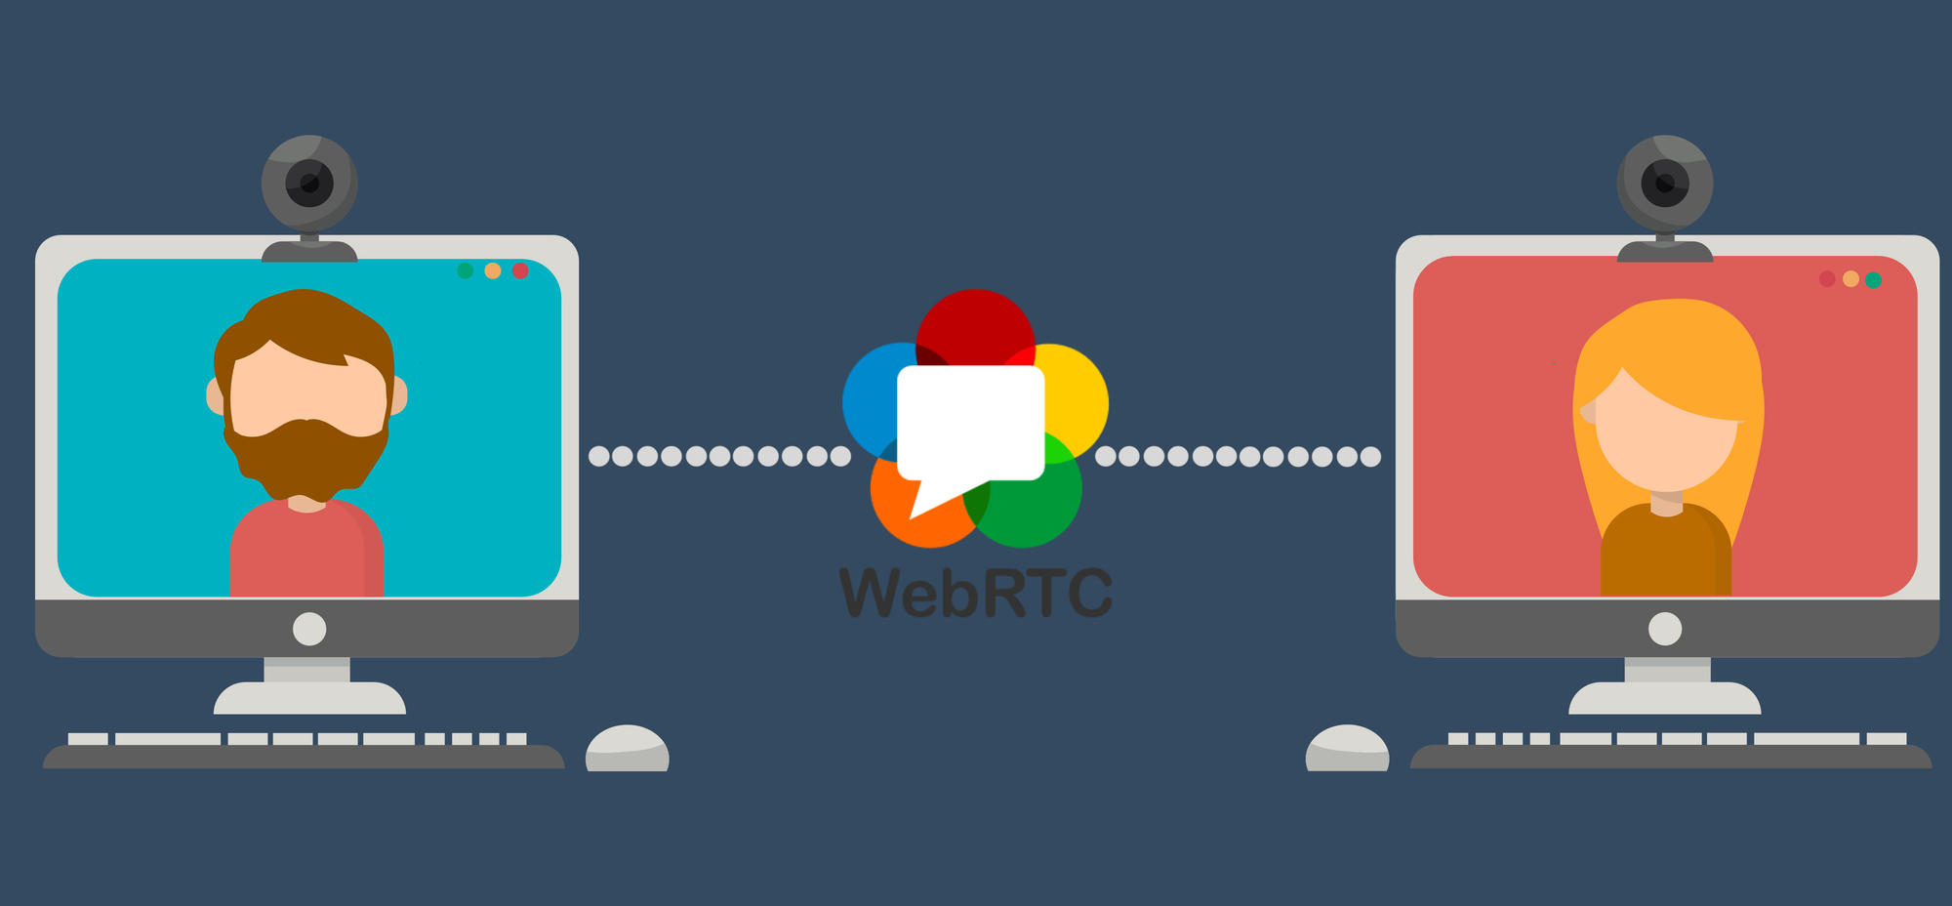
PC Web Pages Can be Enhanced by Client-side Info
Client-side information
Web RTC
Notes:
Nowadays, a growing number of web pages are trying to break the isolation of the sandbox
to retrieve client-side information to enrich there functionalities.
[click]
For example, web RTC is used in Web Conference, it relies on accessing local microphones and cameras from client-side.

Slide 3
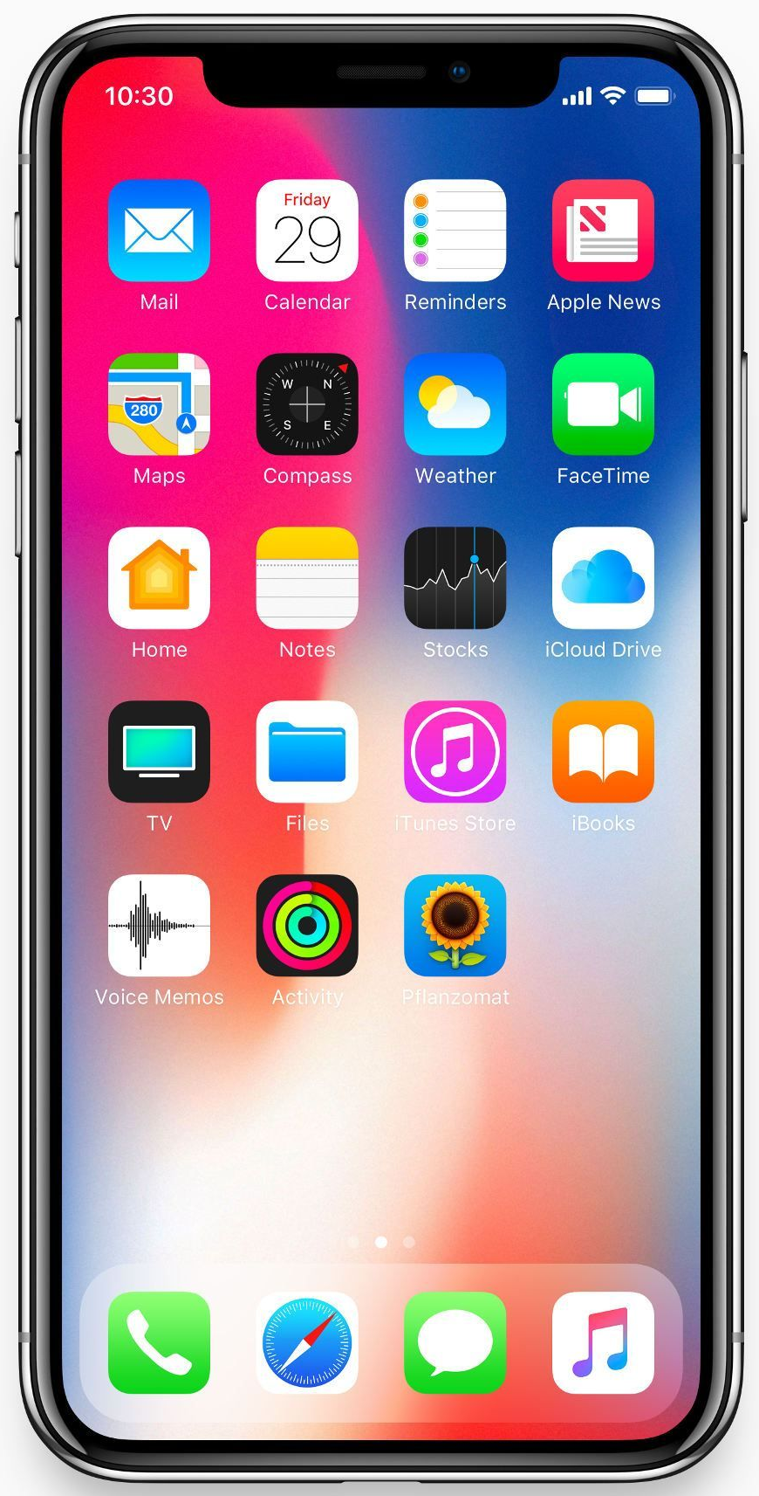
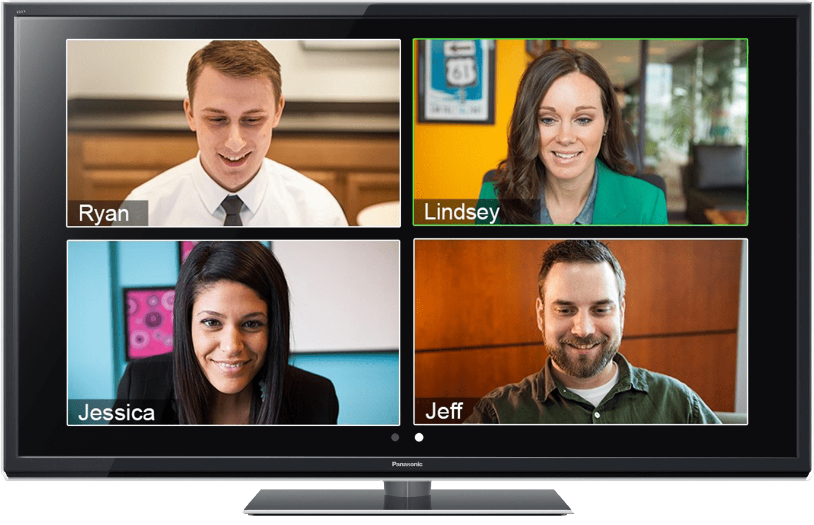
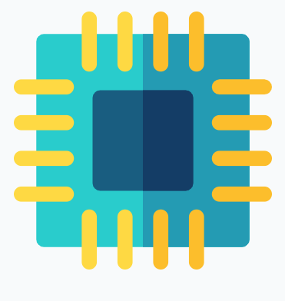
Can PC Web Pages be further enhanced by taking information from the co-located smartphone?
？
Sensors
Personal Data
Web Pages on PC
Notes:
Motivated by the popularity of smartphones, we consider a question following the above trend :
[click]
can PC web pages be further enhanced by taking information from the co-located smartphones?
we believe the answer to the question is positive.
On one hand, smartphones are rich in hardware capabilities, like sensors.
[click]
On the other hand, smartphones also store many personal data, like user accounts.
[click]
It’s beneficial for PC web pages to obtain these information.
Therefore, a smartphone-to-web communication channel would lead to several interesting and beneficial web applications.

Slide 4
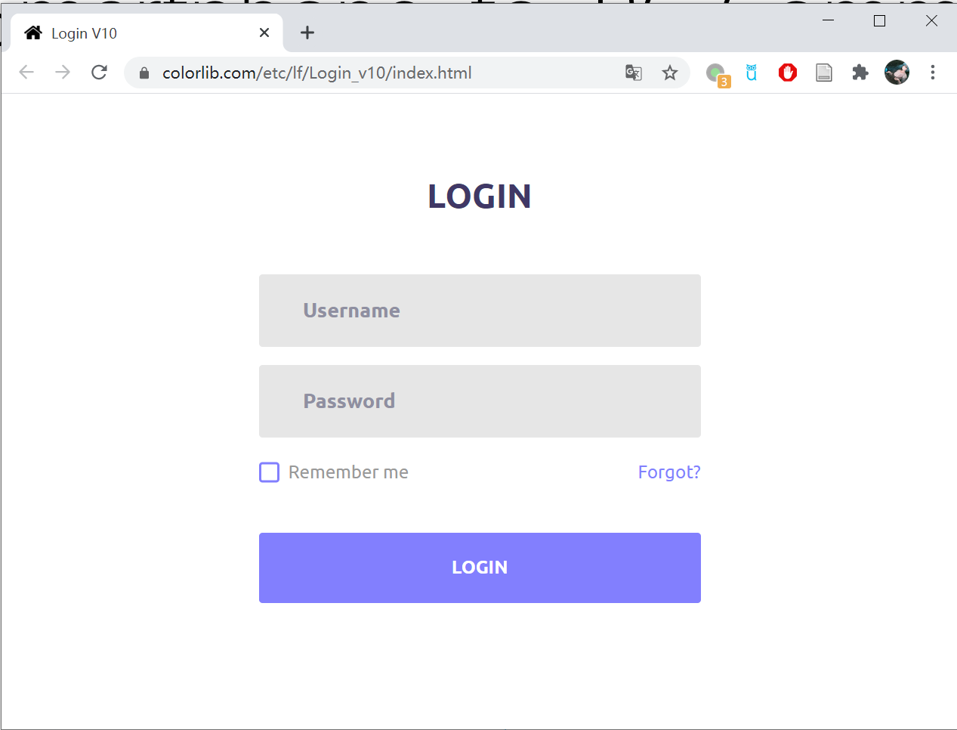
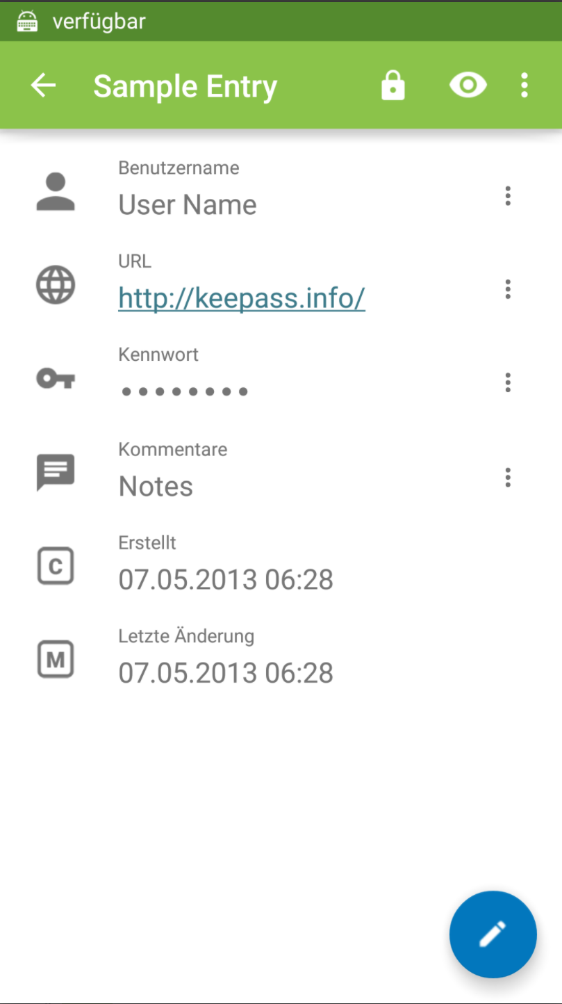
Smartphone-to-Web Communication
Potential Application 1: Password Manager Companion
Retrieving the account and password stored in the smartphone for web login.
http://testlogin.com/
http://testlogin.com/
Credentials
Login web pages on PC
Password manager in smartphone
Notes:
To begin with, we introduce two typical web applications to demonstrate the potentials of the Smartphone-to-Web Communication.
When a user try to login manually, the login may fail due to a wrong password input.
Another option is using the smartphone password manager for auto-login.
[click]
Through a smartphone-to-web channel,
[click]
The web page can retrieve the credentials stored in the smartphone
[click]
Then the user can log-in without entering manually.

Slide 5
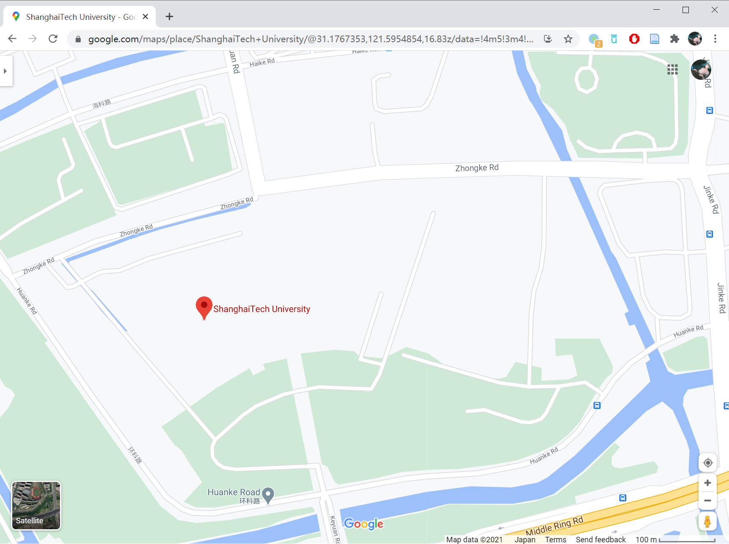
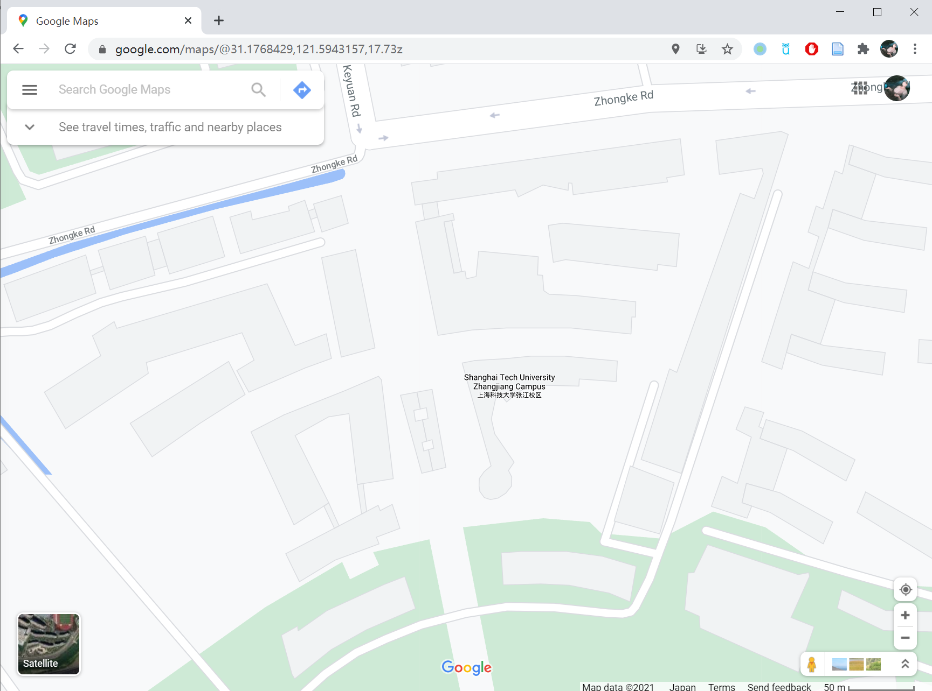
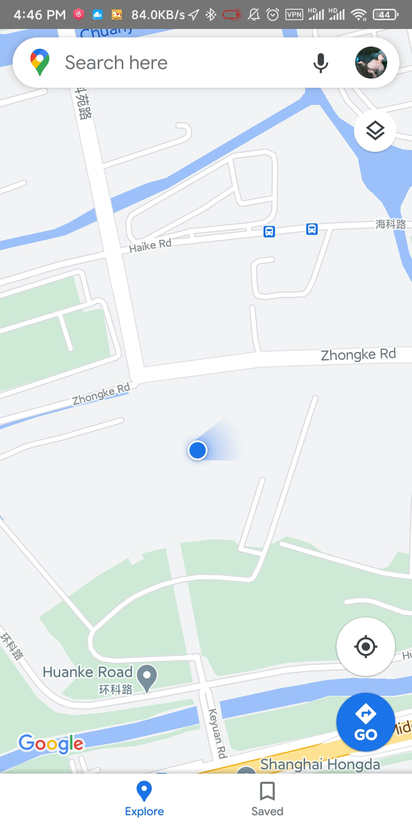
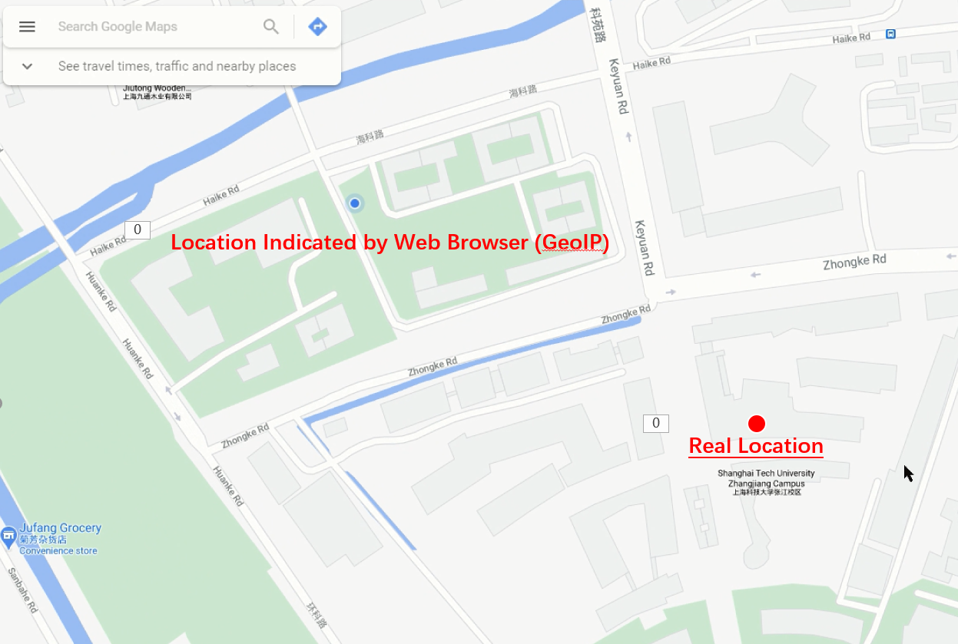
Smartphone-to-Web Communication
Potential Application 2: Precise Location-based Service
Enabling precise location-based service on PC web pages.
Precise Location
Real Location
Precise location from smartphone
Location obtained via sensor-fusion
Wrong location from IP
Notes:
The second application is a Precise Location-based Service for the PC web applications.
To begin with, we compare the location services from the PC web and the smartphone.
[click]
The blue point is the user location Indicated by Web Browser , and the red point is the real location.
We can see that the user location in the PC web is not accurate, because it’s obtained from IP address.
[click]
The second one is the Location obtained via sensor-fusion technique in smartphones.
[click]
Compared with the real location, it is more accurate.
Therefore, if the location from smartphone could be shared to the PC web,
[click]
the user could enable precise location-based services on PC web applications.

Slide 6
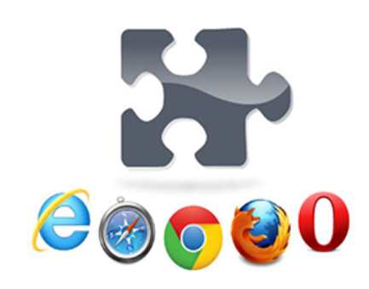
Smartphone-to-Web Communication: Problem
Potential Approaches
Cloud Services
e.g., Your Phone App in Windows 10
Ad-hoc wireless protocols
e.g., Bluetooth
Your Phone App
Limitations
Setup overhead
e.g., link establishment, account sync
Not directly transferring to the web pages !
Additional effort is needed, i.e., installing a browser plugin
Phone-to-PC Path != Phone-to-Web Path
Plug-ins
Notes:
Indeed, There are already several potential approaches for sharing information between smartphones and PCs,
[click]
For example, Cloud Services, such as Your Phone App
[click]
or wireless protocols, such as Bluetooth
but they all have limitations.
they are phone-to-PC sharing rather than phone-to-web sharing.
[click]
The phone-to-PC sharing brings only information to the PC's operating system.
The information is not directed to the web pages.
[click]
Thus, additional effort, such as installing a browser plugin, is needed to further convey the information to the web page.
So, those approaches are not convenient.

Slide 7
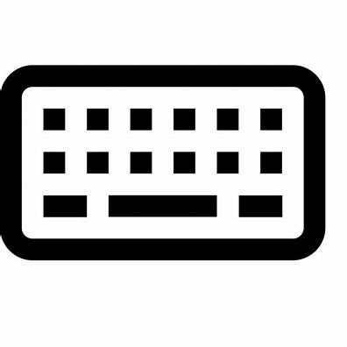
Our Idea: a Channel between Mouse and Smartphone
Putting an optical mouse on top of the smartphone screen, then information from the phone is directly transferred to the web page.
Receiver in
Web Page
Optical Mouse
Share
Transmitter App
PC
Smartphone
Notes:
To this end,
We propose a new approach to realize smartphone-to-web information sharing.
It works by Putting the optical mouse on top of the smartphone screen,
[click]
then information from the smartphone is directly transferred to the web applications.
The key advantage is that no need for pairing and no need to install a browser plug-in.

Slide 8
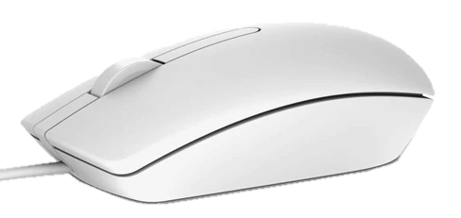
How Do Optical Mice Work?
Mechanism: optical mouse uses image sensor to detect movement.
③ DSP
Y
$$t_{1}$$
$$t_{2}$$
$$t_{3}$$
$$t_{4}$$
A
A
A
A
X
A
② Image Sensor
④ Movement Vectors
① Movements
Lens
… [-2, 0], [-3, 0], [-2, 0], [-1, 0], …
LED
Working surface
Notes:
Next we show how it works,
An optical mouse is a kind of optical imaging system.
[click]
It uses an LED backlight to illuminate the working surface and uses image sensor to detect movements.
[click]
For example, when the mouse is moved leftward,
[click]
the image sensor continuously takes images of the texture ``A‘’ on the working surface.
[click]
Next, according to these captured images of texture ``A‘’,
the digital signal processor of the optical mouse detects rightward movements.
[click]
Then, The mouse reports movement vectors of the leftward direction,
that is the true movements of the optical mouse.

Slide 9
Key Observation
The optical mouse can sense the movements of the display content on the smartphone screen.
Transmitter
Texture
Movements
The PC cursor moves accordingly.
A texture moves on the phone screen.
Notes:
Our design is based on the observation that besides the reflected backlight,
the image sensor of the optical mouse can also capture other light signals,
In particular, the optical mouse can capture the movements of
the display content on the smartphone screen.
[click]
If A texture moves on the phone screen,
the PC cursor will move accordingly
when the optical mouse is put on the screen.
Let’s show our observation.
[click]

Slide 10
Design: Modulating Movement Vectors
Direction Shift Keying
Modulating the shift direction of the texture.
Shifting the texture in the transmitter
Notes:
Therefore, our method to transmit information from smartphone screen to the optical mouse is modulating the shift directions of the texture.
[click]
We call the scheme Direction Shift Keying.
[click]
The right Table shows our mapping, which uses four shift directions as symbols to represent bits.
The last circle represents no shift
for the display texture, which is only used in preamble.

Slide 11
Design: Packet Structure
Fixed pattern
Reed-Solomon (RS) coding for error correction
Preamble for identifying
the beginning of a packet
Preamble
(16)
Payload
(Variable length)
DATA
(22×8)
CRC
(16)
…
DATA
(22×8)
CRC
(16)
Block 1
Block n
RS (32+2t, 32) Code in GF (2⁶)
Channel Coding
Preamble
(16)
6
6
...
6
6
...
6
32 RS-Symbols
2t Repair RS-Symbols
Notes:
Let’s see the packet structure.
Each packet consists of preamble and payload fields.
[click]
We use Reed-Solomon coding for error correction
[click]
and the preamble field to identify the beginning of a packet.

Slide 12
Challenge: Fine Synchronization
Constraints:
Movement Vectors are Noisy
Preamble Sequence is Short
T_{frame} = 16.7 ms
The fine boundary = ?
Screen
→
●
●
↓
↑
↓
Mouse
→ → →
↓ ↓
↑ ↑
↓ ↑
T_{mouse} = 8 ms
Preamble matched
Multiple mouse reports in one frame with noises.
T_{frame}
Preamble-frame
Data-frame
How to find the optimal sample of each symbol?
Notes:
At the receiver side, it’s hard to establish the synchronization due to noises and preamble length.
Ideally, The mouse will report the movement vectors at the moment when the display frame refreshes.
[click]
After the preamble being matched, the data flow from optical mouse is synchronized.
[click]
Then, after each frame, the receiver could obtain a movement vector for decoding.
However, in a real situation, the symbol boundary from Preamble is not accurate，
[click]
thus the receiver could not determine the screen refresh time.
[click]
As the figure shown, Tframe is the time of screen refresh, which is about seventeen microsecond,
and Tmouse is the time between two mouse events, which is about eight microsecond.
[click]
And on average, The mouse reports
two samples per frame with noises.
[click]
so, Without the fine symbol boundary,
the challenge is
How to find the optimal sample of each symbol?

Slide 13
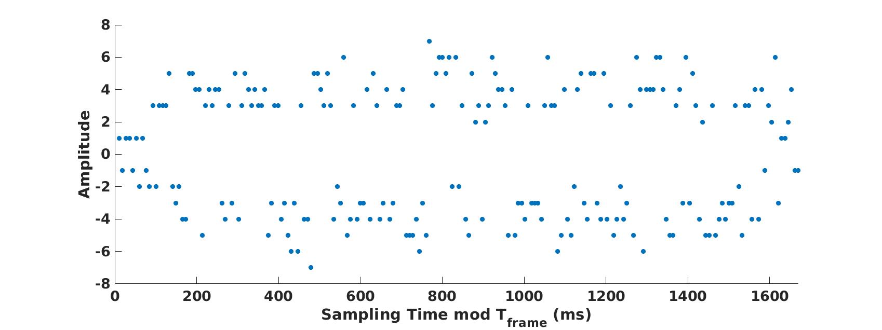
Inferring the Screen Refresh Time from Statistics
The amplitude(one dimension) of reported movement vectors
Amplitude
Observing the statistics by folding the samples into one frame cycle [0,T_{frame}]
Sampling Time (ms)
Notes:
In light of our observation, we could infer the Screen Refresh Time from Statistics.
[click]
Let’s take a look at the received movement vectors after data transmission.
[click]
The X-axis is the sampling time and the y-axis is the amplitude of reported movement vectors.
The texture under the mouse moves randomly,
and the obtained mouse amplitude is shown in the figure, involving high and low absolute values
[click]
We can observe the statistics by folding the samples into one Tframe.

Slide 14
Inferring the Screen Refresh Time from Statistics
Folding samples into one frame cycle [0,T_{frame}]
T_{frame}
T_{frame}
T_{frame}
Amplitude (X-axis)
T_{frame}
2*T_{frame}
2*T_{frame}
T_{frame}
8
16
24
32
40
48
56
T_{mouse}
Sampling Time mod T_{frame} (ms)
Sampling Time (ms)
Notes:
In order to find the screen refresh time,
[click]
we choose one Tframe as the base to overlay these samples.
[click]
The X-axis is changed to Sampling Time modulo the Tframe
[click]
The movement vectors are all folded in one T_{frame.}

Slide 15
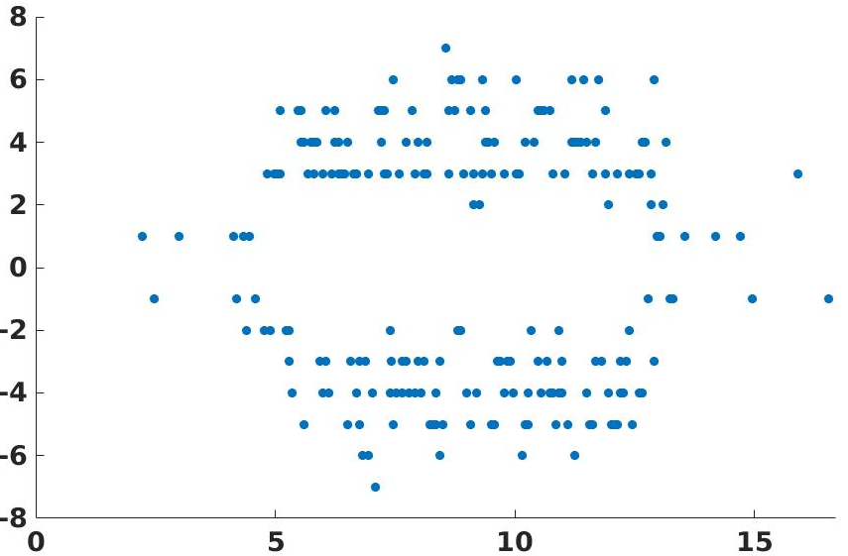
Inferring the Screen Refresh Time from Statistics
Observation:
High-amplitude samples are concentrated in one mouse cycle [0,T_{mouse}], i.e., the blue window.
T_{mouse}
Why ?
Amplitude (X-axis)
The blue window reflects the time slots of the mouse events just after screen refreshes
high intensity of movement stimulation.
Sampling Time mod T_{frame} (ms)
Notes:
The result is shown in the figure.
[click]
We can find that High-amplitude data
are concentrated in the blue window,
that is one Tmouse.
Based on the observed results,
when the reporting event is the one just after the screen refresh,
its amplitude is usually large.
[click]
Therefore, the blue window reflects the time slots of the mouse events just after screen refreshes.
For each frame, the event in the blue window is more accurate.

Slide 16
Design: Re-sampling
The Reference Optimal Sampling Time (t_{opt}):
The centers of the blue window in each frame.
t_{opt}
Amplitude (X-axis)
Thus, we can re-sample each frame by only selecting the mouse events in the blue window.
Sampling Time mod T_{frame} (ms)
Notes:
We could re-sample each frame by only selecting the mouse events in the blue window.
for re-sampling and demodulation,
we define the center of the blue window in each frame as The reference Optimal Sampling Time
[click]
We could use the value to choose the optimal samples of mouse events.

Slide 17
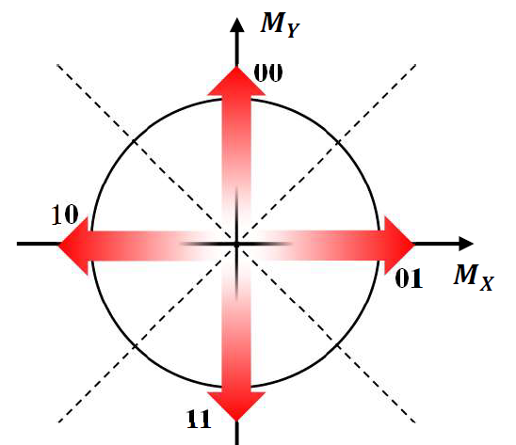
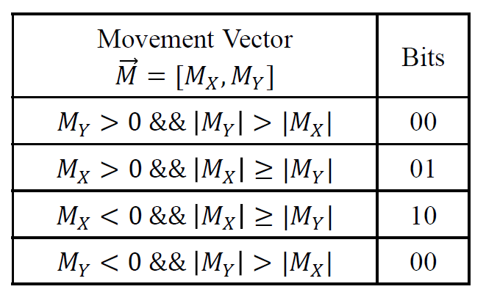
Design: Re-sampling and Demodulation
Choosing the Sample Close to t_{opt} in Each Frame
t_{opt}
t_{opt}
t_{opt}
T_{mouse}
↓ ↑ ↓
↑
11 00 11
Mouse
↓
↑
↑
↓
↓
↓
↓
↓
T_{frame}
T_{frame}
T_{mouse}
Re-sampling movement vectors
Mapping the movement vectors into bits.
Notes:
For instance, the mouse reports an event at the beginning of each box, represented by the blue movement vectors.
[click]
the receiver will choose the sample close to the optimal time as the movement vector in Each Frame for demodulation.
[click]
Then, We get the red movement vectors of down, up and down.
[click]
According to The right Table, the movement vectors could be mapped to bits.
[click]
That is 11 00 11.

Slide 18
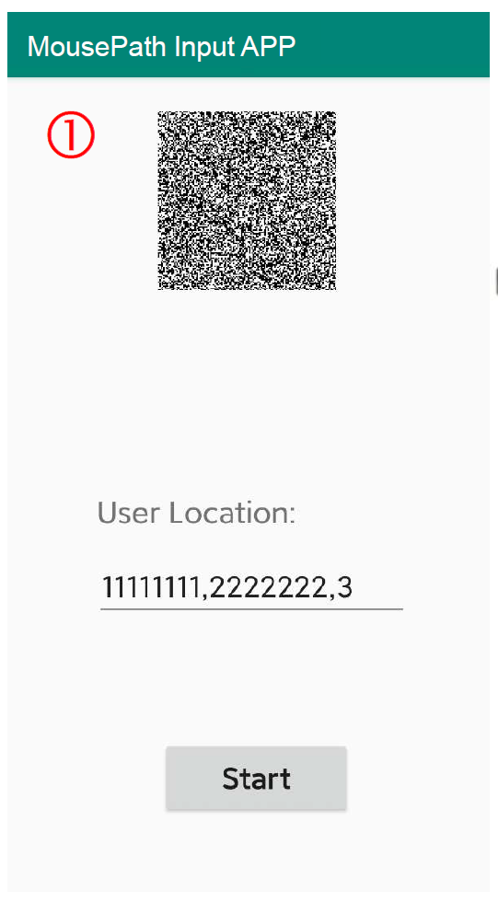
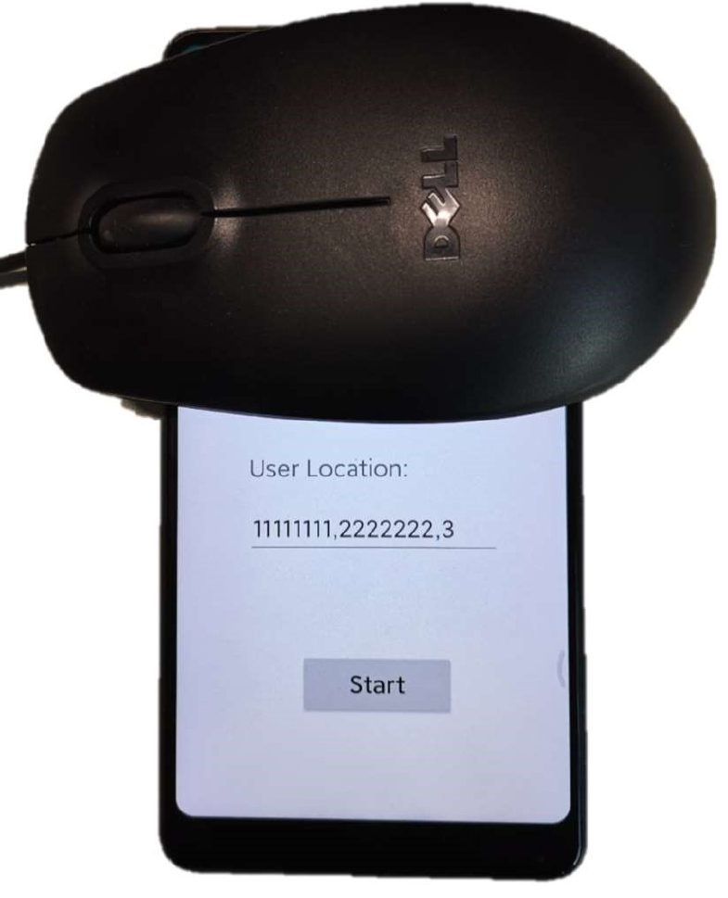
Implementation
Transmitter App in the Smartphone
① Movement texture
② Click ‘Start’ to transmit the precise location to the web application
Transmitter UI for location sharing
Putting the mouse on the screen
Notes:
Next, let’s take a brief look at the implementation of our system.
We take location sharing as an example.
We developed a Transmitter App in the Smartphone.
The left is the UI for location sharing.
[click]
At the top is the movement texture.
[click]
Users put the mouse on the texture area
and Click ‘Start’ button to transmit the precise location to the PC .

Slide 19
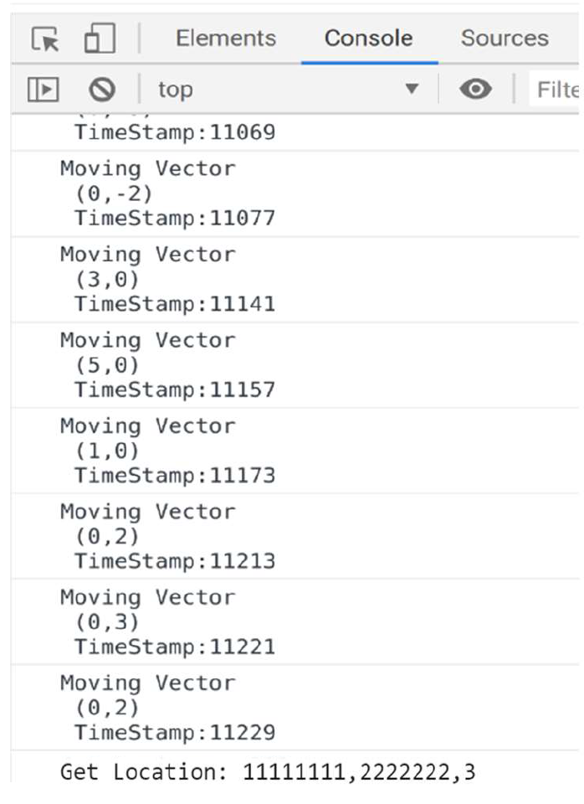
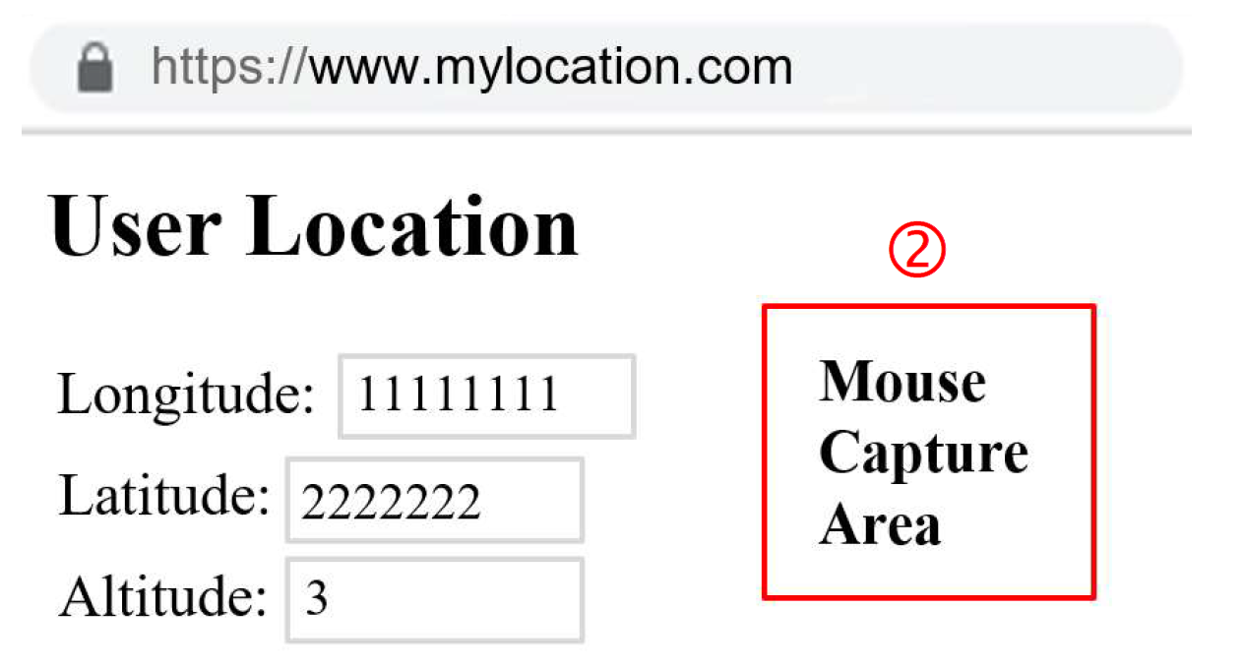
Implementation
Receiver JavaScript in the Web Page
④ Mouse move events from mousemove listener
③Use Mouse Lock API
to avoid cursor random walk
The layout of MousePath-enabled web page
Output from the browser’s console
Notes:
The target web page runs a piece of JavaScript code as the receiver and no plug-in is needed.
[click]
The users click in the mouse capture area to lock the cursor via Mouse Lock API ,
so as to prevent the cursor from moving out of the web page.
[click]
Then, the receiver will capture all mouse move events from mousemove listener in javascript
So that the user location could be decoded

Slide 20
Evaluation on Device-related Factors
Error Rate V.S. Different Hardware:
(a) Xiaomi Mix 2S with LCD Screen
(b) Xiaomi 8 with OLED Screen
Notes:
In this part, we evaluate the performance of our system on different smartphones and mouse models.
[click]
The following Figures plot the CDFs of symbol error rate for different combinations of smartphones and mice.
The performances of three optical mice are different,
as different models have different sensitivities in their detecting algorithms
From Figure (a), we can see that the model with the best performance on Xiaomi Mix 2S is DELL MS111,
[click]
the most symbol error rate is less than 3 percent. which is low enough to transmit short messages.
[click]
Figure (a) and (b) also shown the impact of different screen types.
We notice that the performances of LCD and OLED are almost same.

Slide 21
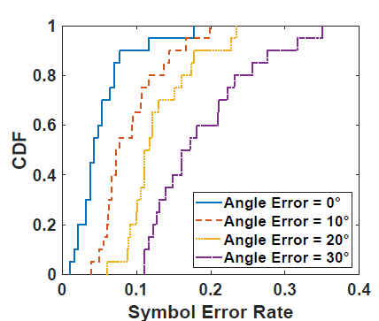
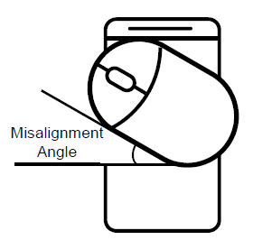
Evaluation on Texture-related Factors
Angle Error:
Notes:
Next, we evaluate the impact of angle error,
[click]
which is the misalignment angle between the mouse and the texture.
[click]
The right figure plots the CDF of symbol error rate versus the angle.
When the angle increases, the performance becomes worse.
[click]
From the figure, we can find that when the angle is 10 degree or less,
the most symbol error rate is less than 10 percent ,
which is enough for data transmission.
Moreover, According to our experience,
when the user places the mouse on the screen,
the angle error is usually within 10 degree .
For the evaluation of other features, please refer to our paper.
presentation
The is the end of our, I’m happy to answer any questions.

Slide 22
Q&A

Slide 23
Thank you!
Notes:
Thank you for listening.

